Slide 1
A Picture is Worth 1000 Words:
Visual Literacy and EE
Jan Weaver

Slide 2
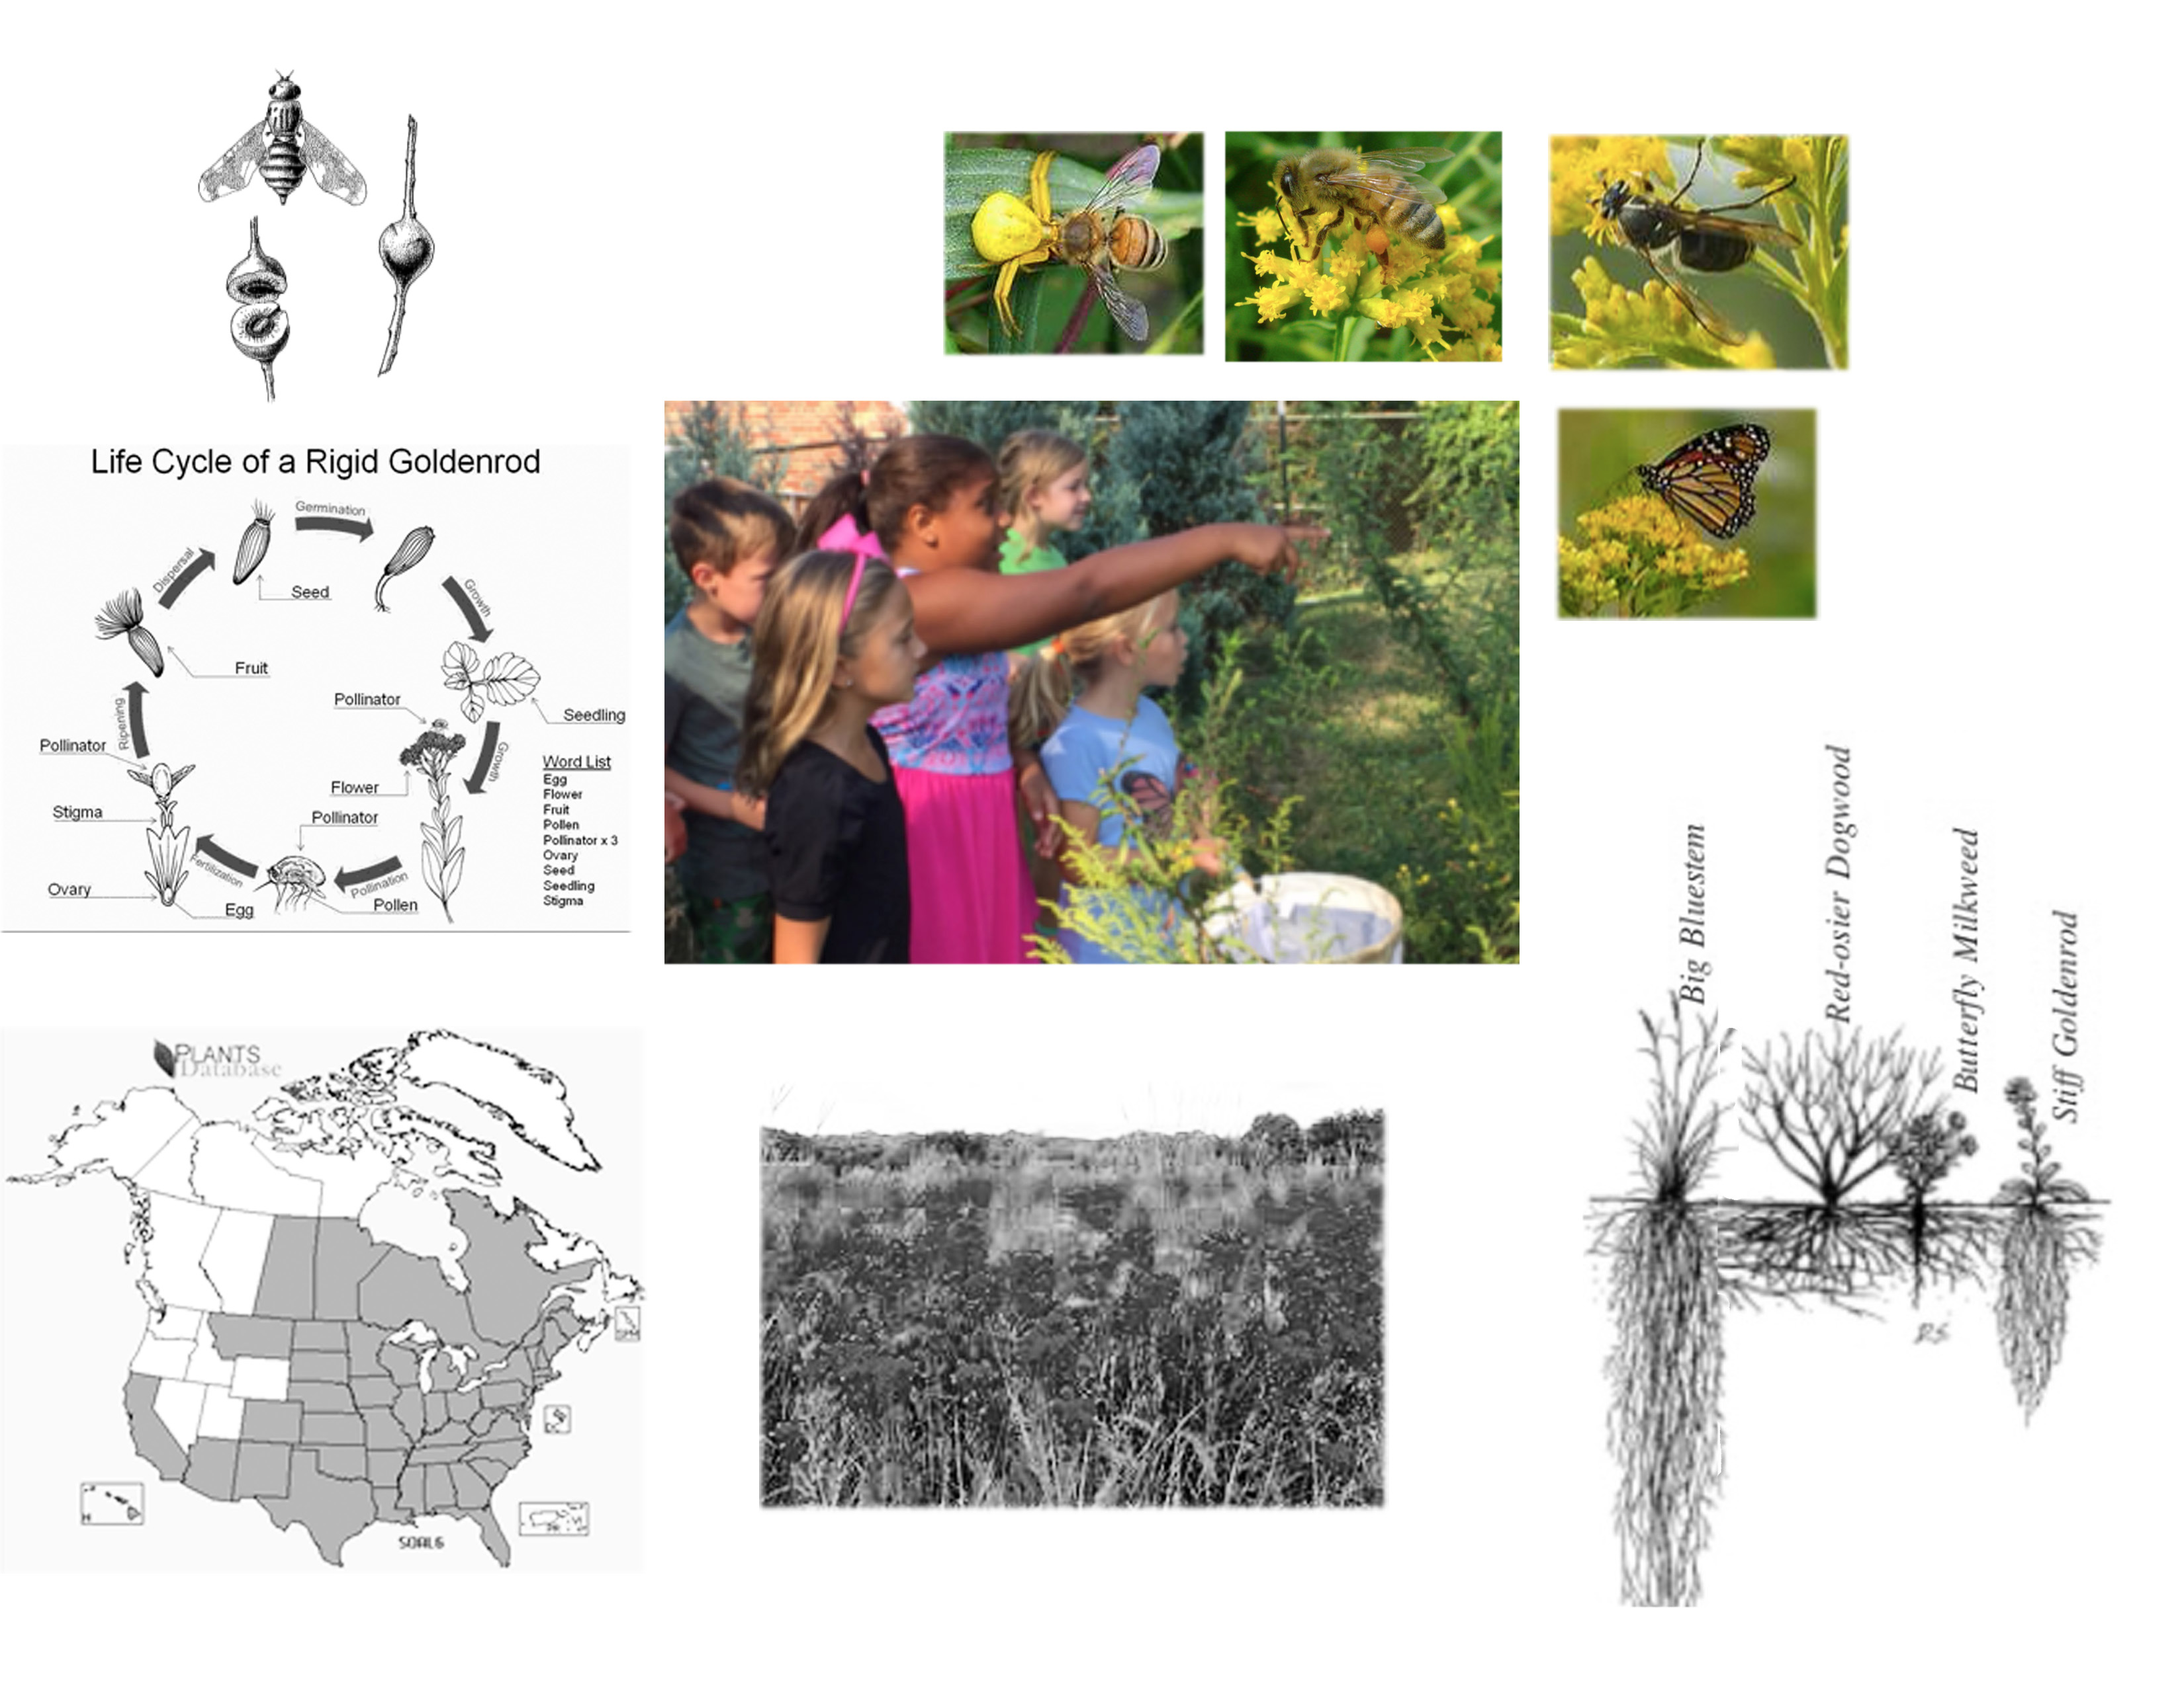
Notes:
Good graphics (in black and white) add scale, time, relationships and context to an outdoor experience (in color)

Slide 3
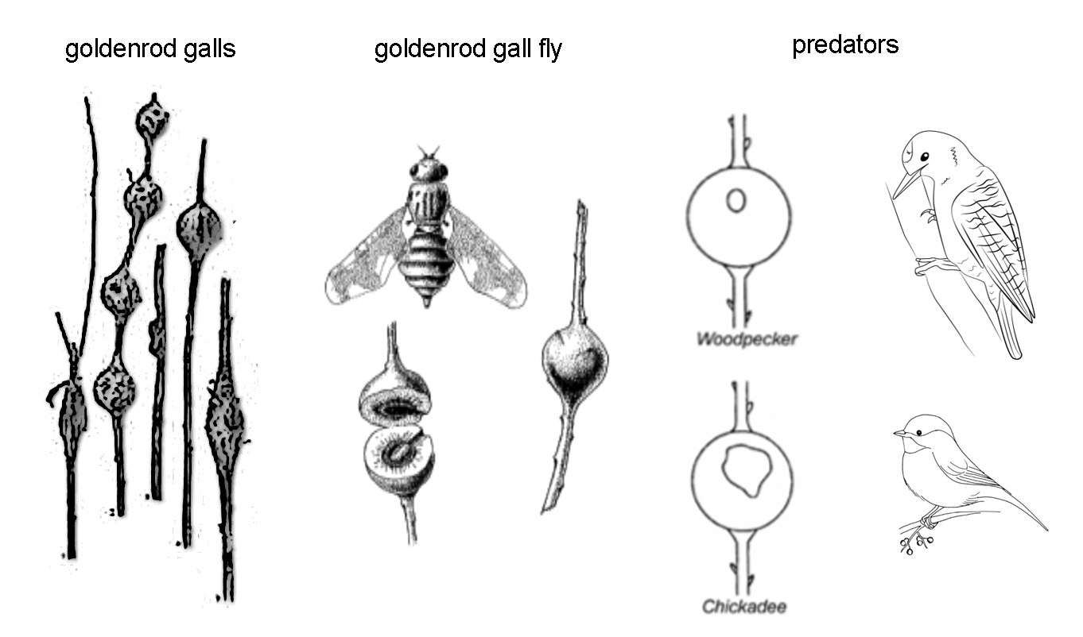
Notes:
Good graphics make information available to those who are pre-literate or understand a different language

Slide 4
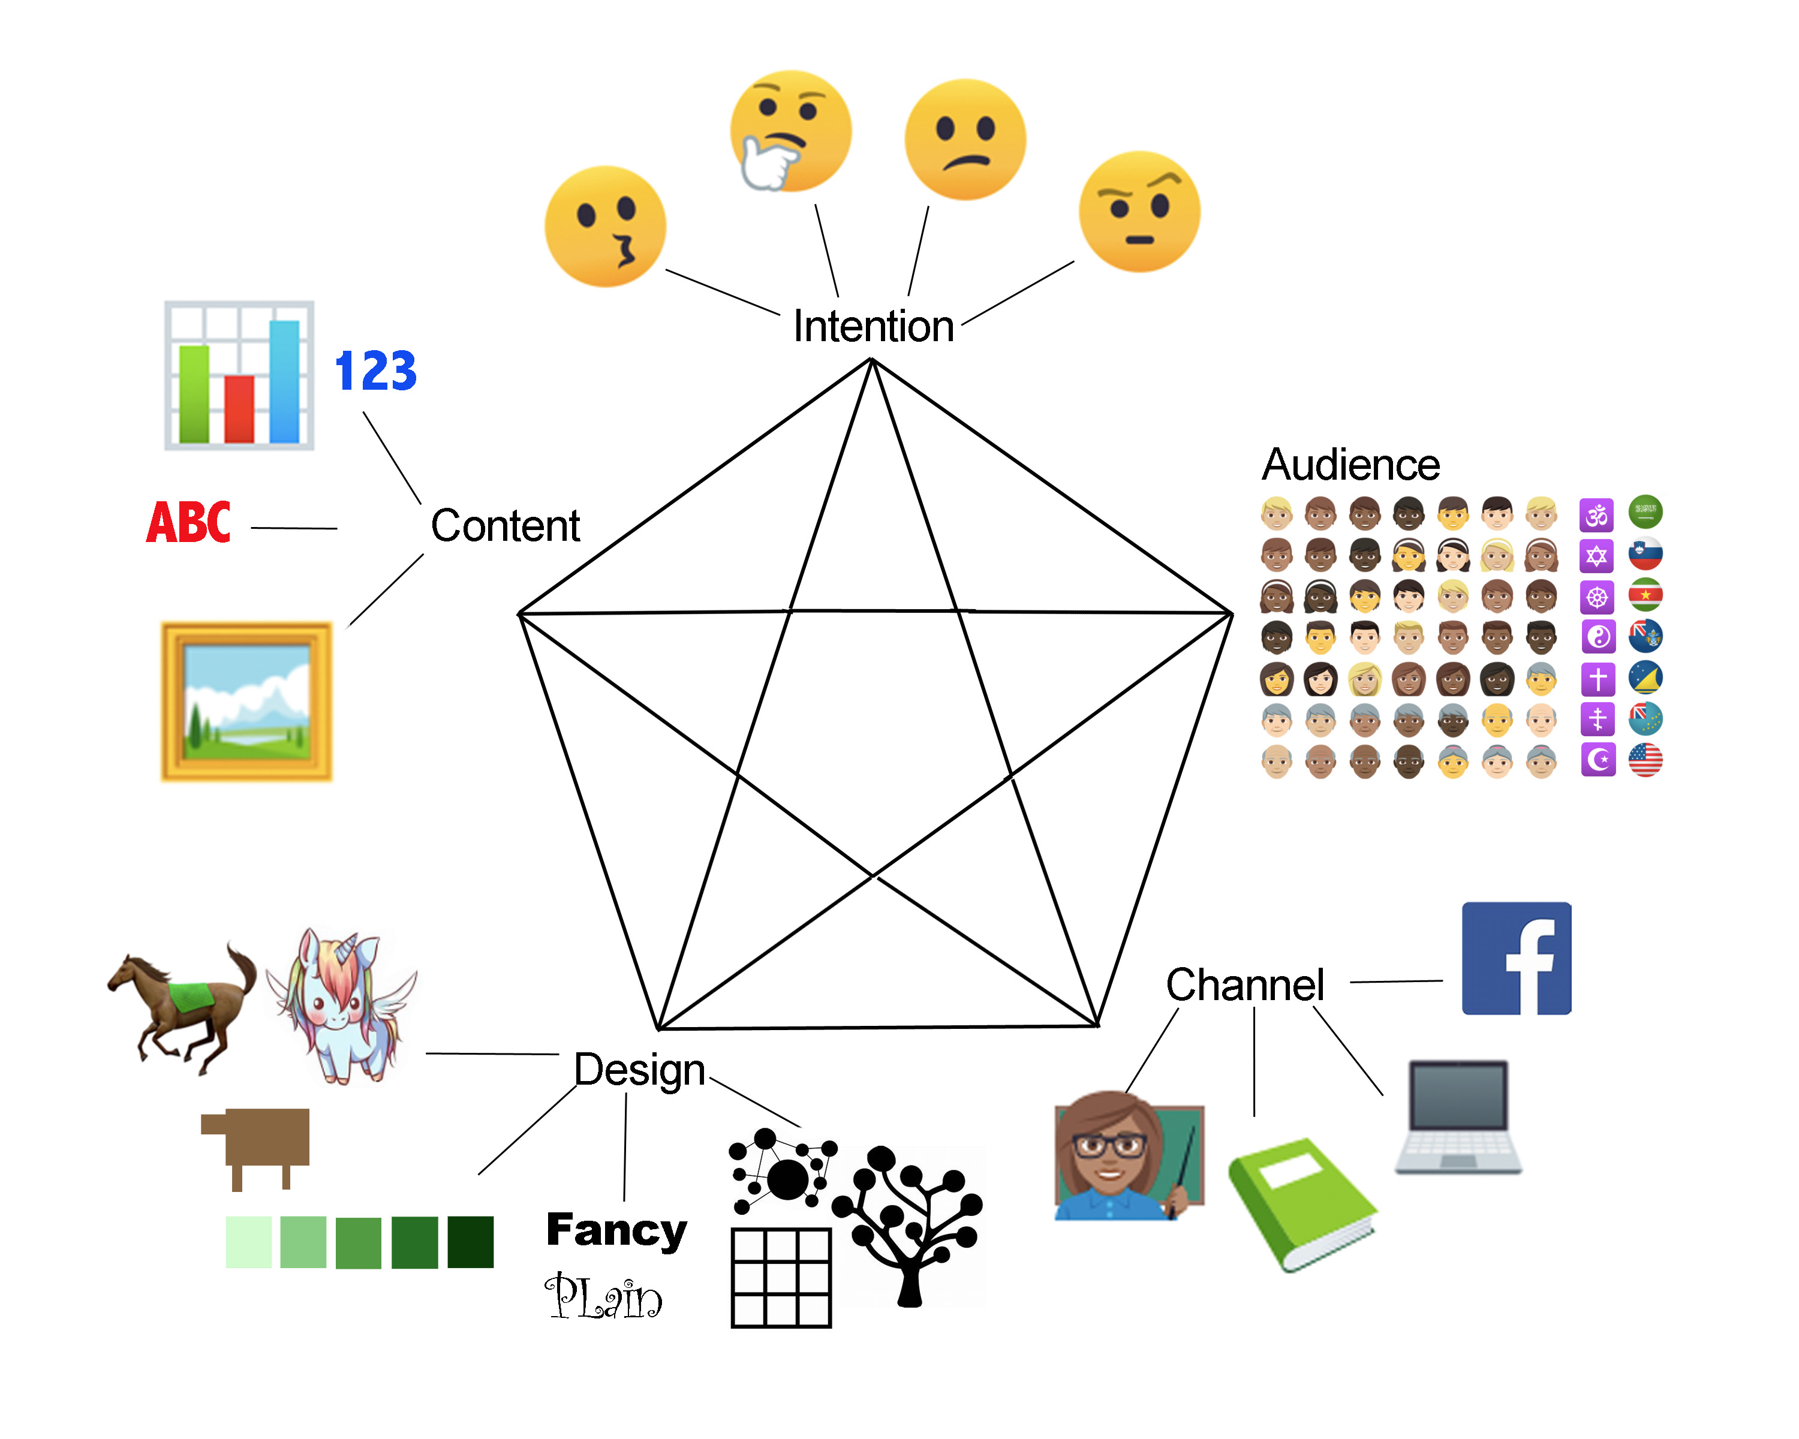
Notes:
This is a simple 5-part model of what should be considered in creating an educational graphic. The use of emojis to illustrate the concepts is in
tended to keep the focus on planning a visual and away from any particular artistic style.

Slide 5
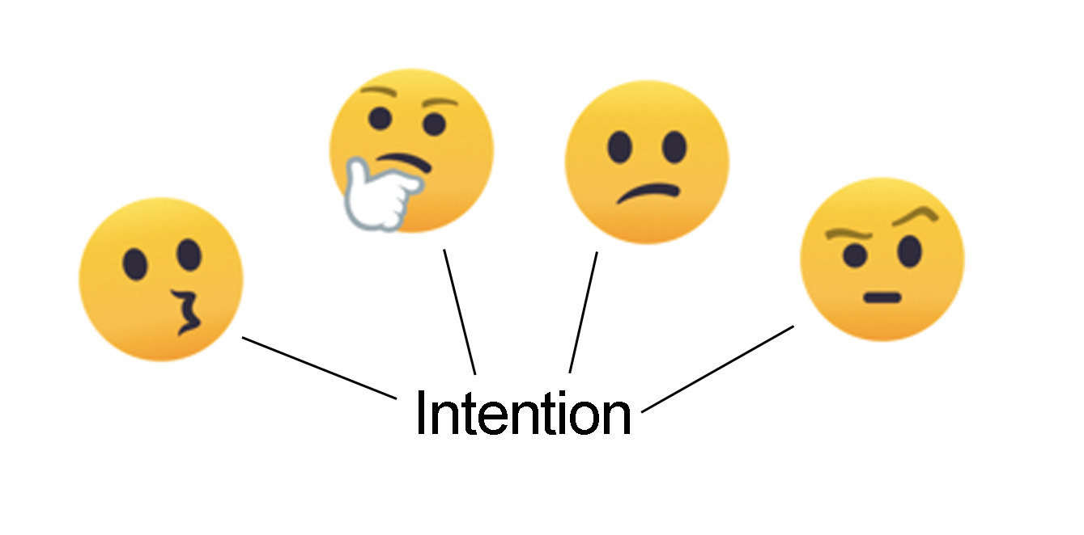
Notes:
Intention is the effect you want to produce in your audience – from left to right: wonder/awareness, thoughtfulness, concern, and intention and ability to act

Slide 6
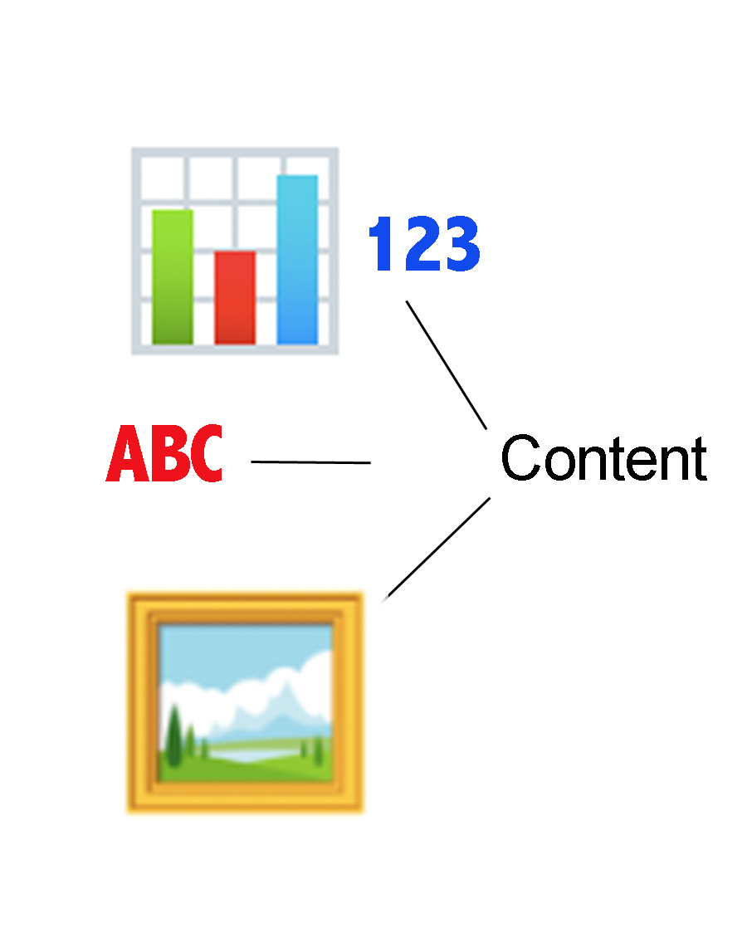
Notes:
Content is the data, graphs, text and images you will use to populate your graphic.

Slide 7
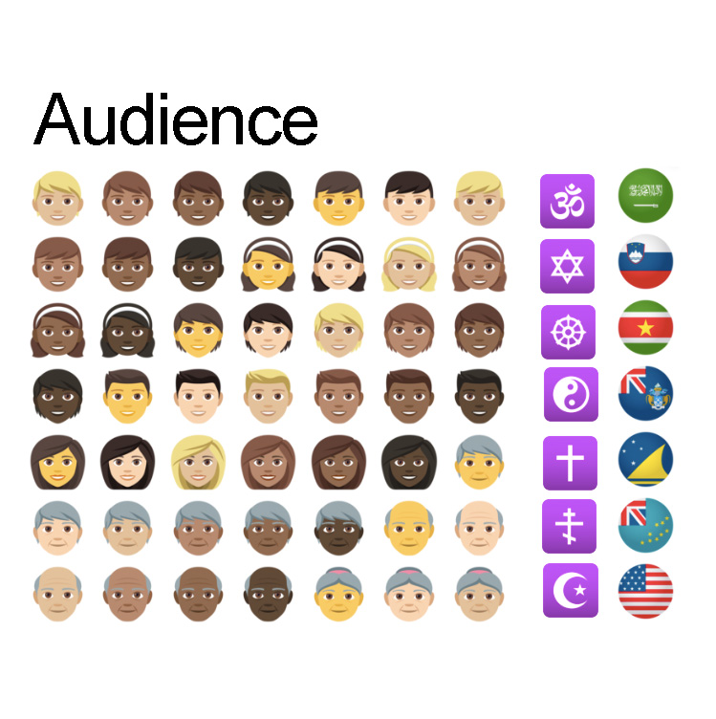
Notes:
Audience is the specific group of people in which you want to produce an effect (wonder, thought, concern, action). You need to consider age, race, gender, ethnicity, religion, national origin, income, politics and interests. You cannot create something that appeals to everyone and that still achieves your intention. You can, however, create something that appeals to different audiences.

Slide 8
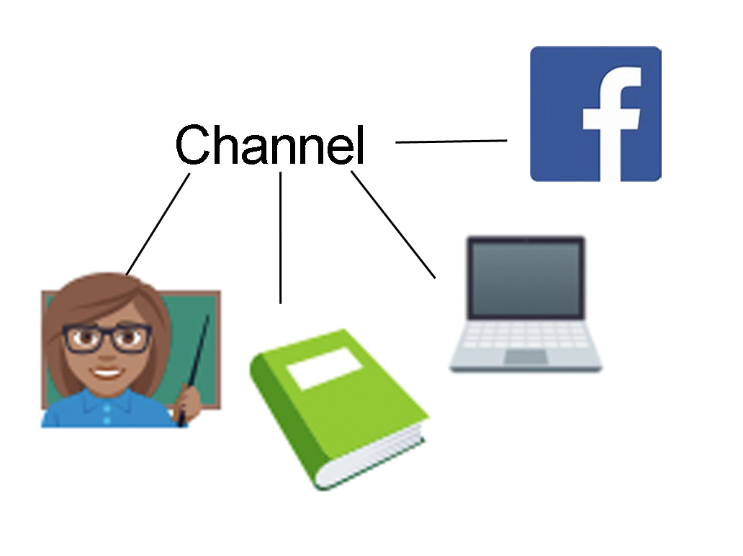
Notes:
Channel is the way your audiences will be able to access your visual. The choice of channel affects how they will interact with it and how you design it. Something for a powerpoint presentation will only be seen for a short time, but will have someone to explain it. Something for a book or a pamphlet has to stand on its own, but is available to the viewer for a longer period of time and can be viewed again.

Slide 9
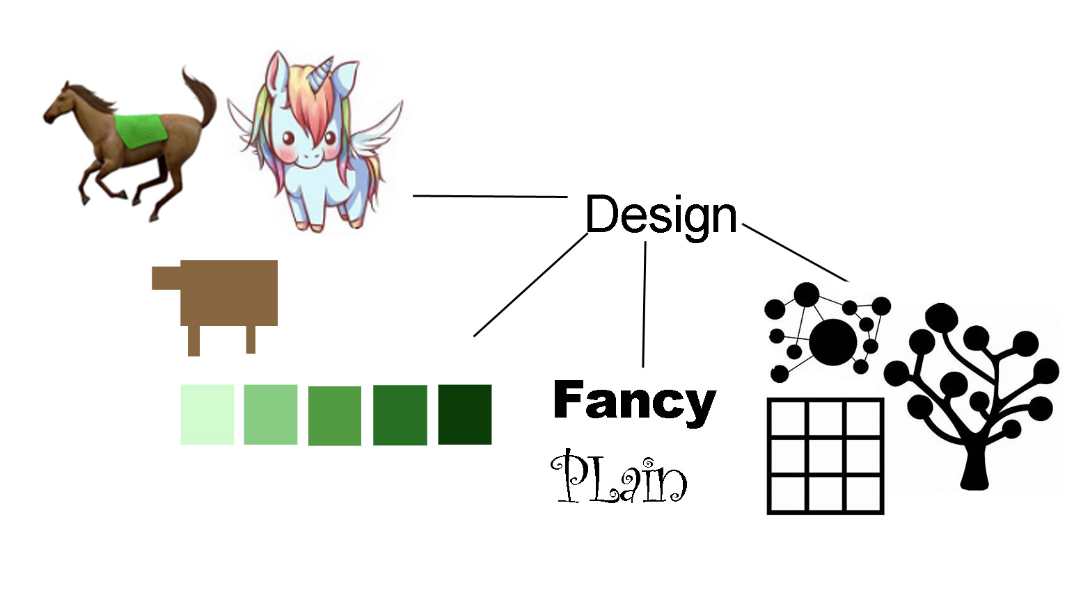
Notes:
Design is about what you put in the graphic. The horses represent different artistic treatments to consider, realistic, abstract and fantastic. The green squares represent the range of tints/shades that can be used. (Tip – a limited palette of 5 shades, light to dark, is very effective. Use dark and light contrast to draw the eye of the viewer). The Fancy/Plain fonts illustrate the power of font design to overwhelm the meaning of the text. It is important to choose a font that reinforces your message. The grid, network and tree represent different ways of arranging your content in your visual. A grid may be appropriate when all your content elements have the same importance. A network or a metaphor like a tree will emphasize the kind of relationship your elements have to each other. (Tip – in western culture the viewer looks at the center first, then tracks to the upper left, the upper right, the lower right and the lower left in a clockwise direction. Since the goal of a good visual is to keep the viewer’s interest you want to avoid placing things in the center. Instead, divide the space into thirds and place your key messages or points where the lines intersect. )

Slide 10
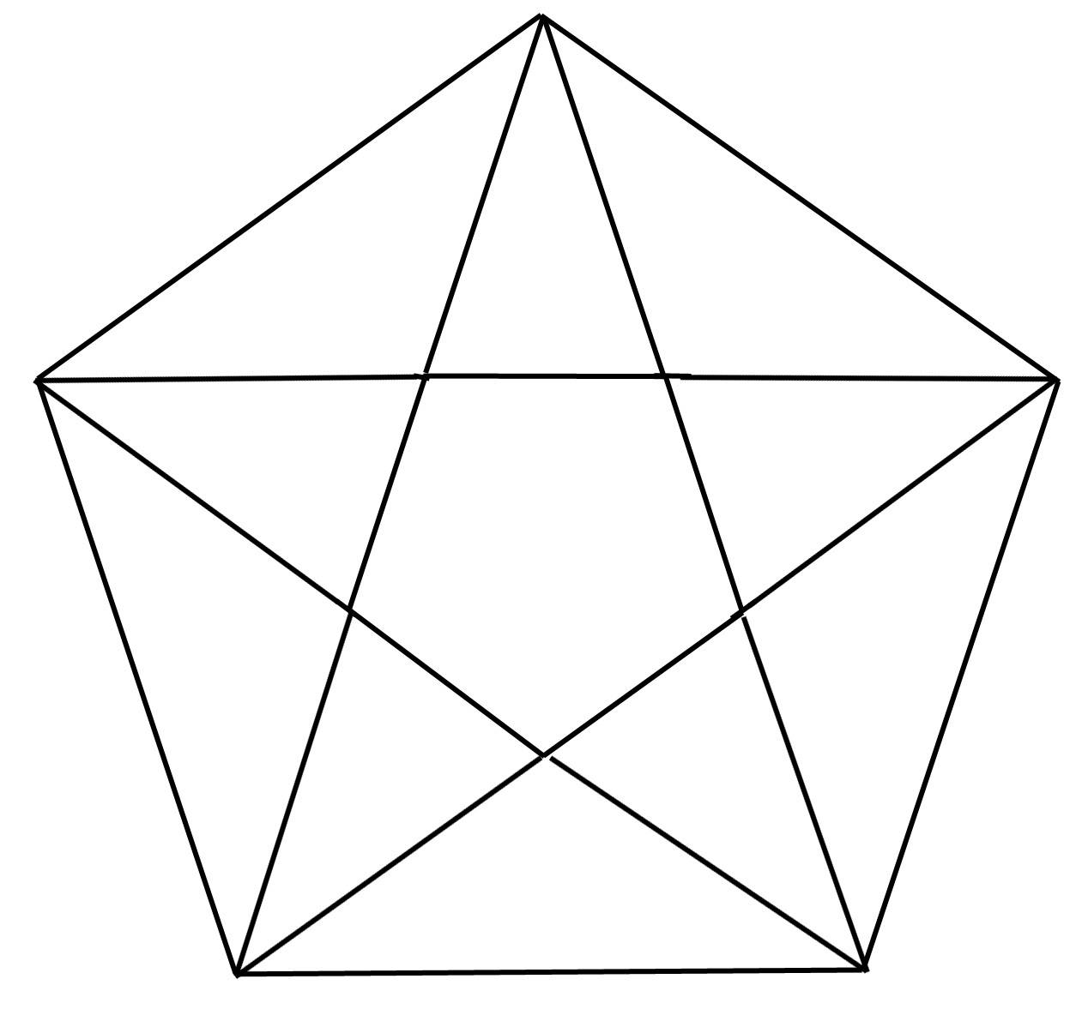
Notes:
The pentagon-star shows every part connected to every other part. While you may start with intention, every choice you make about any part of the visual affects the other parts. Every time you make a decision for one part, you should consider its impact on all the other parts.

Slide 11
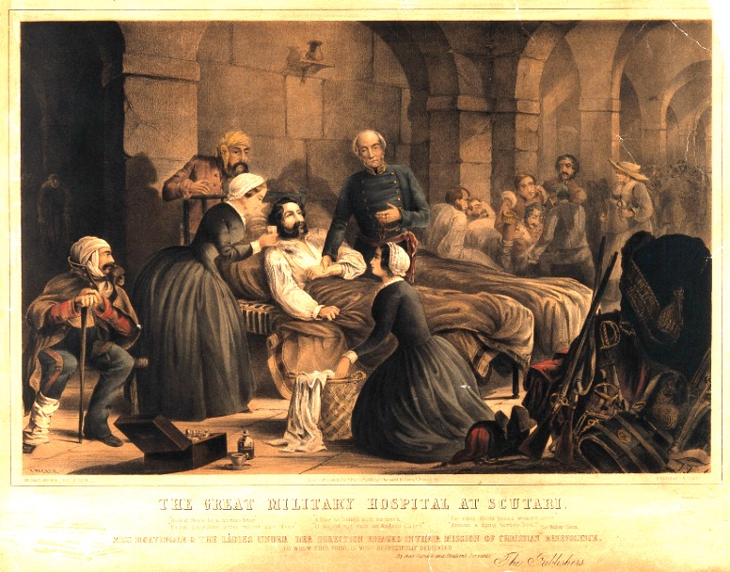
Notes:
A very brief history of the use of quantitative graphics. Crimean War 1853-1856. This painting of the military hospital at Scutari shows Florence Nightengale and one of her trained nurses relieving the suffering of a wounded soldier. The conditions at the hospital were dire, with more soldiers dying from typhoid and cholera than their wounds. Nightengale hammered the war office to bring in a sanitary commission to fix the sewers, she had healthier invalids scrub the hospital down and she organized the kitchens to provide safe healthy foods.

Slide 12
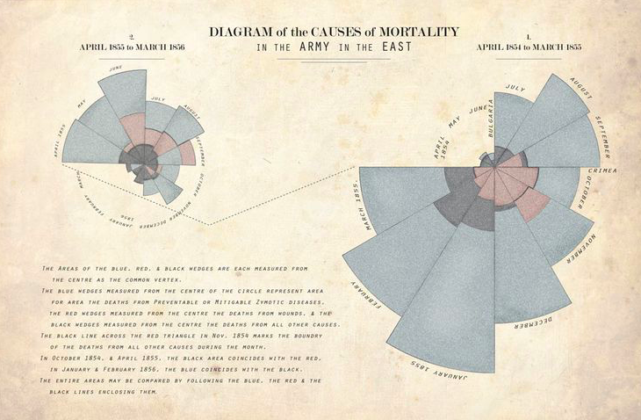
Notes:
The painting in the previous slide is a snapshot in time, but Nightengale wanted to persuade the British government to institute her sanitary measures in British hospitals. She needed to show the impact of her changes. This is a polar graphic, with the monthly mortality rates represented by wedges arranged in a circle. Red was for war wounds, blue for deaths caused by contagious diseases and black for other causes. All causes start from the center and are laid on top of each other. The graphic starts in April 1854 in the right polar diagram at the 9:00 position, circles round to March 1855 when the sanitary commission came in, then shifts to the left polar diagram at April 1855 at the 9:00 position circling around to March 1856. It is obvious that after the work of the sanitary commission, and Nightengale’s other measures, that deaths from contagious diseases dropped dramatically.
Analyzing this visual using the 5 part model: Intention – convince the government to institute sanitary practices; Audience – government, Queen Victoria; Channel – 800 page report; Content – pre and post mortality data; Design – polar diagram*, colors somewhat reflective of the cause of mortality and with colors that printed well given the technology available, simple and small label font so the graph carries the message. * The x axis data were months and the y axis data were deaths. In polar diagrams, the area of the wedge increases disproportionately with the value of y. It has the effect of magnifying the impact of contagion relative to war wounds because viewers give more weight to area than to length. Knowing what we know now about perception, it would be considered somewhat unfair to use this type of graph for comparing relative impacts.

Slide 13
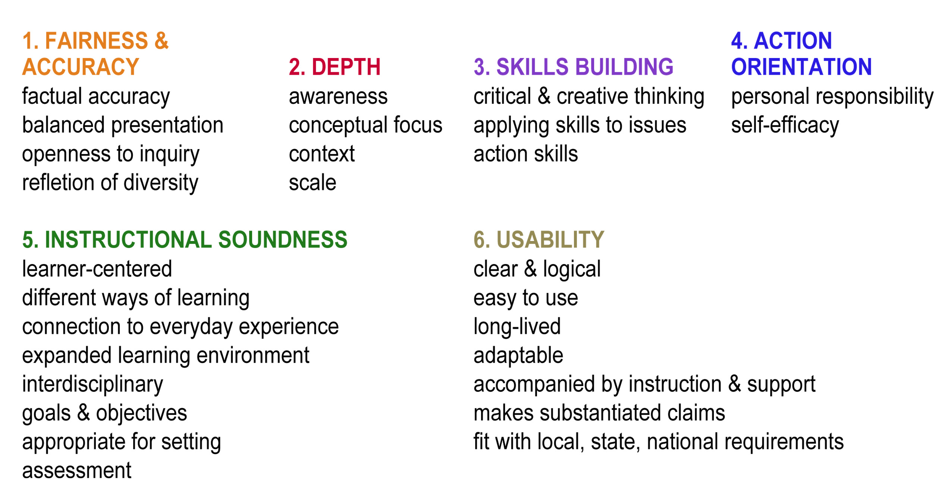
NAAEE Guidelines for Excellence: EE Materials
Notes:
With the 5-part model in place, it is important to see how it works with NAAEE Guidelines for Excellence in Environmental Education Materials. This slide lists the components that need to be considered.

Slide 14
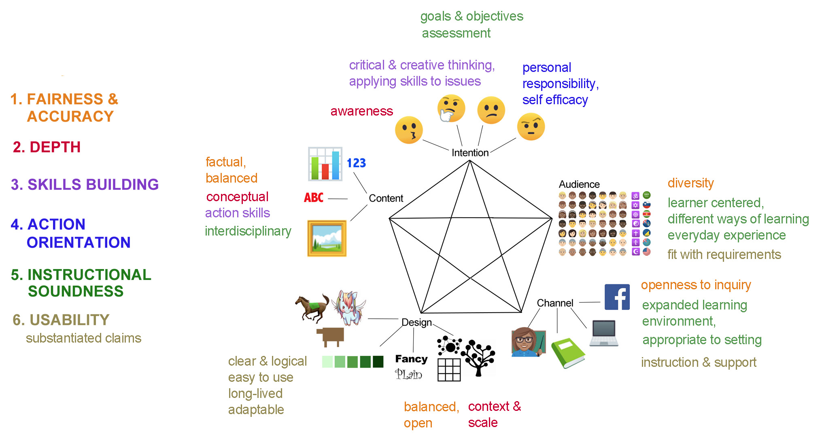
Notes:
This slide shows were in the 5-part model for planning a visual the NAAEE Guidelines for Environmental Education Materials would be a consideration. To illustrate, when you select your audience, you need to consider its diversity, how to keep the visual learn centered, the different ways of learning (visual vs. aural or hands-on), how it could connect with the viewer’s everyday experience and how it fits with any local, state or national requirements (especially important if your audience includes teachers).

Slide 15
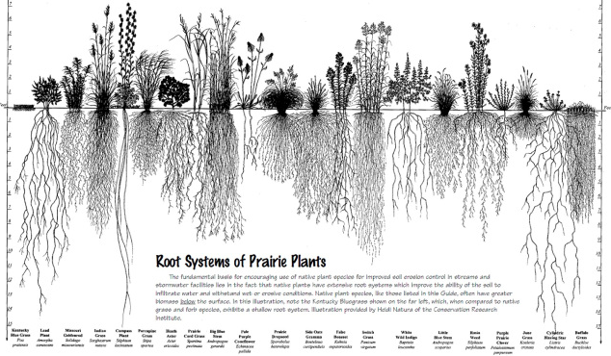
Intention – Audience – Content – Channel - Design
Notes:
I’d like each of you to pick at least one element and comment in the chat – intention was …
Intention – to increase awareness of, invoke wonder about the root systems of prairie plants, invite comparisons between root lengths of prairie grasses and that of a typical lawn grass (on the far left).
Audience - visitors to a nature center with a prairie, students in a region that has prairie
Content – data on plants, the lengths of their root systems, images of the different species
Channel – works as an 8.5 x 11 handout, poster, image on a video screen or power point (though resolution is an issue)
Design – images of plants are the focus, names and length measurements in a small font on the edges, plants are arranged with alternating root lengths instead of by shortest to longest, which may keep the eye moving and making comparisons, and emphasizes diversity, black and white image focuses attention on structure, the composition is grid-like, giving equal weight to each species, which also reinforces the idea of diversity, large font is a casual style that fits with the outdoors natural appeal of the material.

Slide 16
More Examples
Notes:
The next few slides provide opportunities to analyze other visuals using the 5-part model.

Slide 17
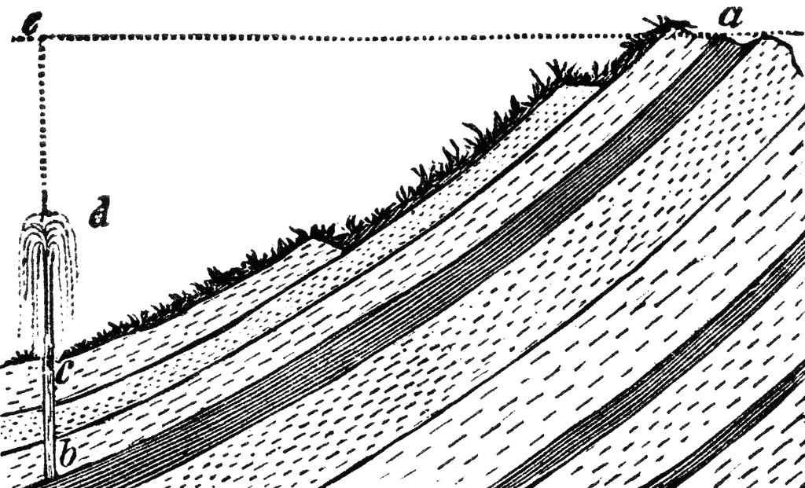

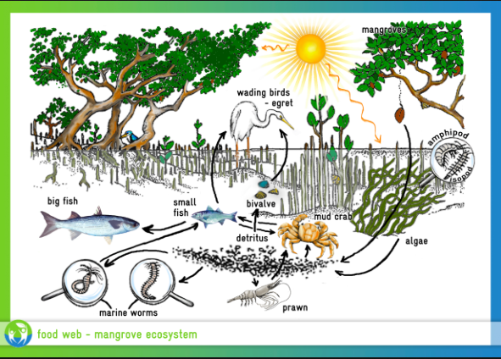
Intention
Audience
Content
Channel
Design
Notes:
Choose one of these images and take a few minutes to see if you can comment on the decision involved in each of the 5 elements and then we can share

Slide 18
Notes:
Intention – awareness, thoughtfulness
Audience – complex, so older students
Data – relationships
Design – web of relationships, but all have the same weight, realistic but simplified
Channel – text book, need time to study

Slide 19
Notes:
Intention – awe, motivate a visit to the park
Audience – almost anyone over the age of 9 with an interest in the outdoors
Channel – large format poster
Design – limited palette, distinctive font designed especially for all the national park posters
Content– image, list of what to expect or do, branding NPS

Slide 20
Notes:
Intention – convey information
Content – how artesian well works
Audience – high school or college students in earth sciences
Channel – text book
Design – realistic and stylelized elements, important features labled with letters so important information can be packed into a text rich caption
Artesian Well from Clip Art - https://etc.usf.edu/clipart/

Slide 21
Design your own visual
Intention
Audience
Content
Channel
Design
Notes:
Think about your own work – is there something you are doing where a visual could help? Jot your idea down on a piece of paper along with the five elements. Then make some decisions about your visual. To start go in order from intention to design.

Slide 22
Edward Tufte
https://www.edwardtufte.com/tufte/
Why People Make Bad Charts
https://flowingdata.com/2018/06/28/why-people-make-bad-charts-and-what-to-do-when-it-happens/
Free Clip Art (historical illustrations)
https://etc.usf.edu/clipart/
Notes:
Conclusion – This 5 part-model is just a ladder to move you towards a more nuanced understanding of how visuals work. Feel free to modify it or to look for other models to use. The best way to improve your visual literacy and your ability to create visuals is to look at lots of good and bad examples, just like the best way to learn to write is to read lots of good and bad writing. Just search for “good visuals” and “bad visuals” on the internet. You can also check out the links provided for a more systematic exploration of visuals.

